Slide 1
COMBATTING NEIGHBORHOOD THEFTS
- A DATA ENGINEERING APPROACH
Presented by: Group 9
Harish Inavolu Suprathika Vangari Vishala Vadla
Udaya Adepu Sai Likitha Uppala Rajeshwari Chiraboina

Slide 2
CONTENTS
Overview
Introduction – Problem Statement and Importance
Data Generation and Collection
Project Initialization and Infrastructure Setup
Data Processing with Open Refine
Data Storage with GCP
Data Management
Advanced Analysis using Hive and Spark
Key Findings and Recommendations
Conclusion
References

Slide 3
OVERVIEW
Neighborhood thefts pose a significant challenge to the safety and well-being of our community. In this project, we leveraged the power of data engineering via GCP to uncover insights and develop strategies to address this pressing issue

Slide 4
The Problem: With rising temperatures during the summer, so do the property thefts in the neighborhood. With longer days and vacations, homes become vulnerable, and criminals seize the opportunity. Importance: By understanding the underlying patterns and factors contributing to neighborhood thefts, we can empower local authorities and community leaders to implement targeted solutions that enhance safety and improve the quality of life for Denton residents.
INTRODUCTION

Slide 5
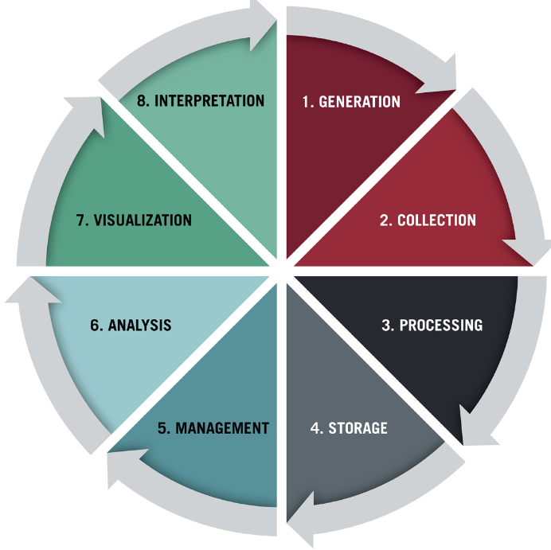
IMPLEMENTATION THROUGH DATA LIFECYCLE
Identified Sources in the form of static datasets
Open Refine
Google Cloud Platform
Google Cloud Storage
Big Query, Hive & Spark SQL

Slide 6

DATA GENERATION & COLLECTION
We identified several key sources for generating data related to neighborhood thefts. Some of them include:
Police Department Records
Community Reports
Sensor data
By utilizing these diverse data sources and collection methods, we were able to assemble 3 static datasets that provided valuable insights into the patterns and contributing factors behind neighborhood thefts in Denton.
https://communitycrimemap.com/
https://data.syr.gov/datasets/5b53f40abbc54c559ca991c96816cc17_0/about
https://www.dallasopendata.com/Public-Safety/Police-Incidents/qv6i-rri7/about_data
Data generation and collection. (n.d.). Shutter Stock.

Slide 7
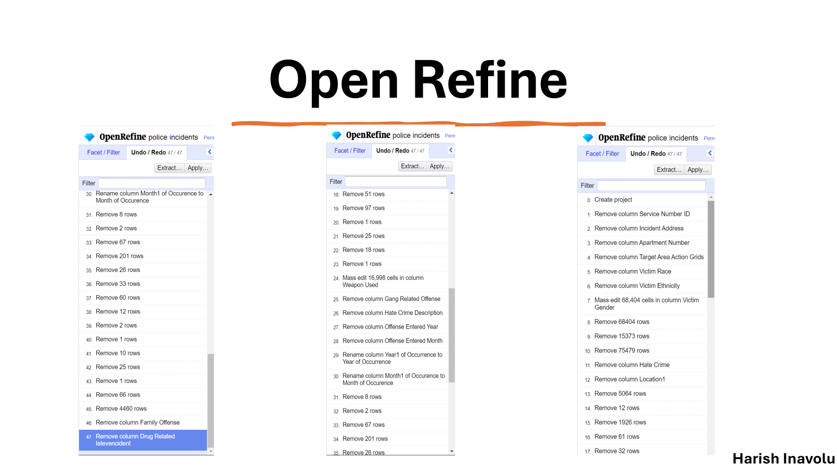
DATA PROCESSING USING OPEN REFINE
We employed OpenRefine to ensure the quality and integrity of our data, we Data Cleaning and Preparation Techniques we used:
OpenRefine helped us remove duplicates, standardize data formats, and handle missing values, by ensuring a clean and consistent dataset for further analysis.
We also utilized OpenRefine's advanced features to detect and resolve inconsistencies in the data, enhancing the overall data quality.
By Harish Inavolu

Slide 8
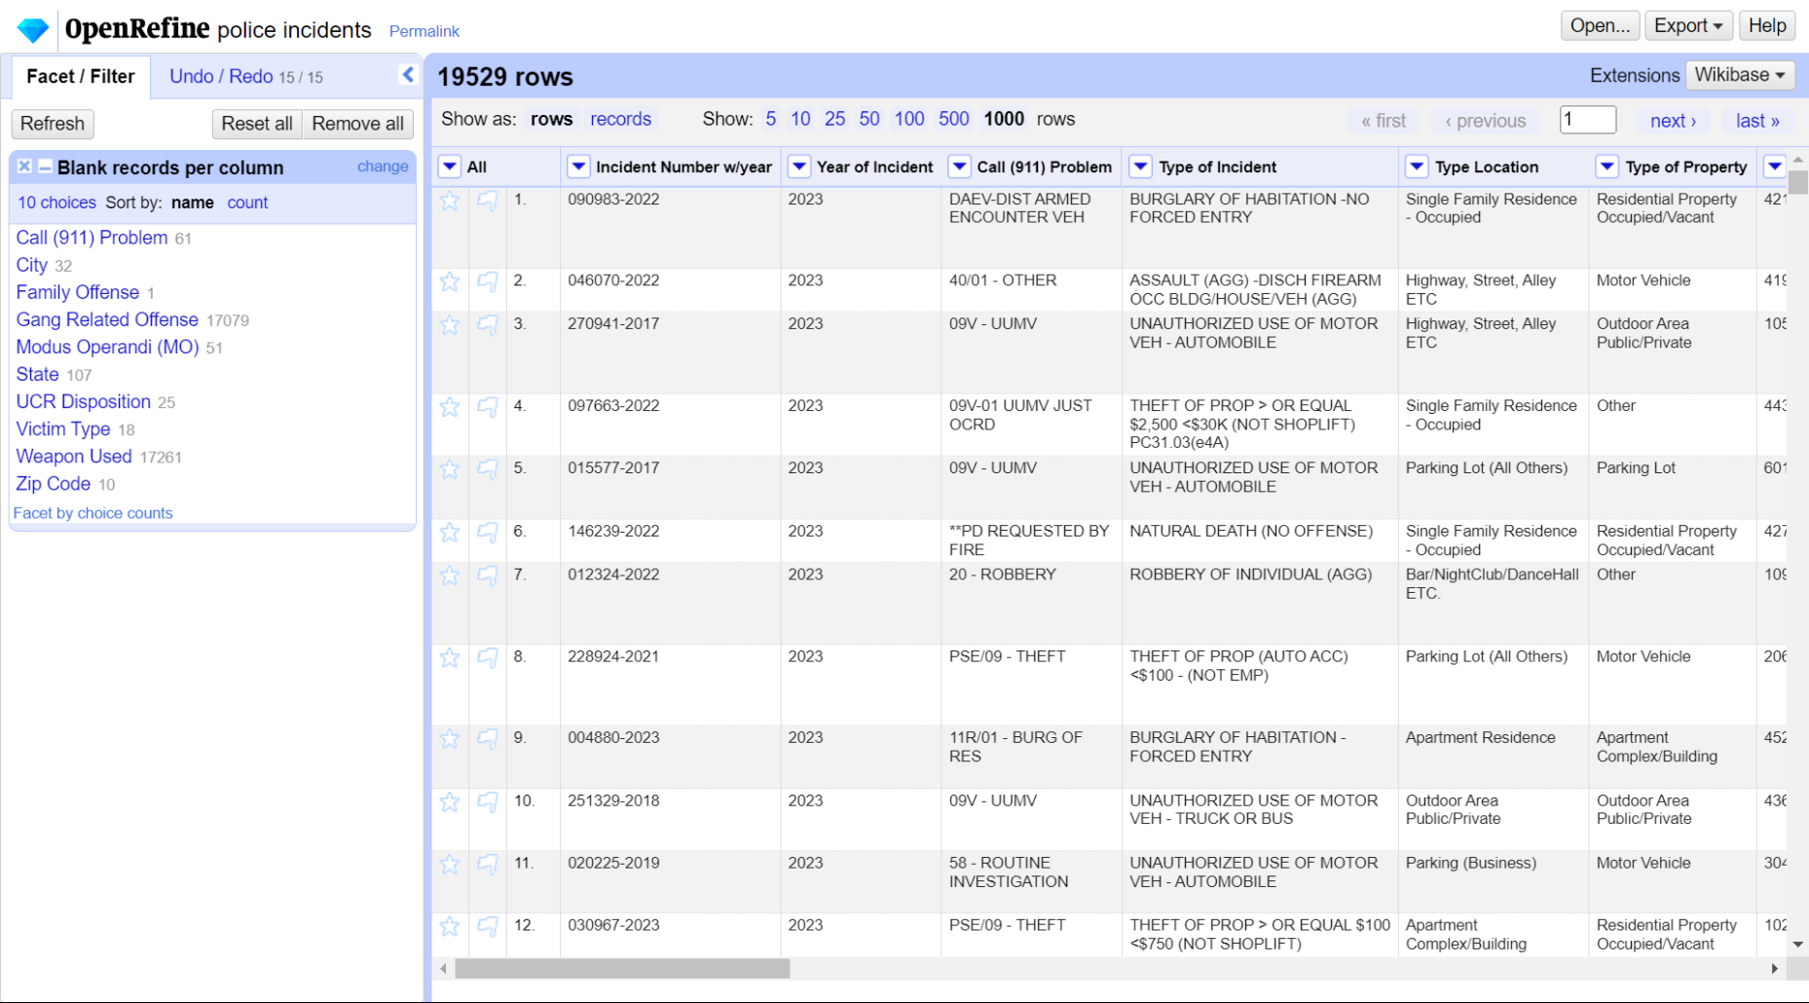
Screenshot – OpenRefine interface Selected blank facets as part of data cleaning process.
By Harish Inavolu

Slide 9

DATA STORAGE USING GOOGLE CLOUD STORAGE
Upon cleaning and processing the data, we utilized Google Cloud Storage buckets to store the datasets.
Cloud Storage provided us with a centralized and easily accessible repository for the processed data, facilitating seamless data sharing and integration across various GCP services throughout our data engineering pipeline.

Slide 10
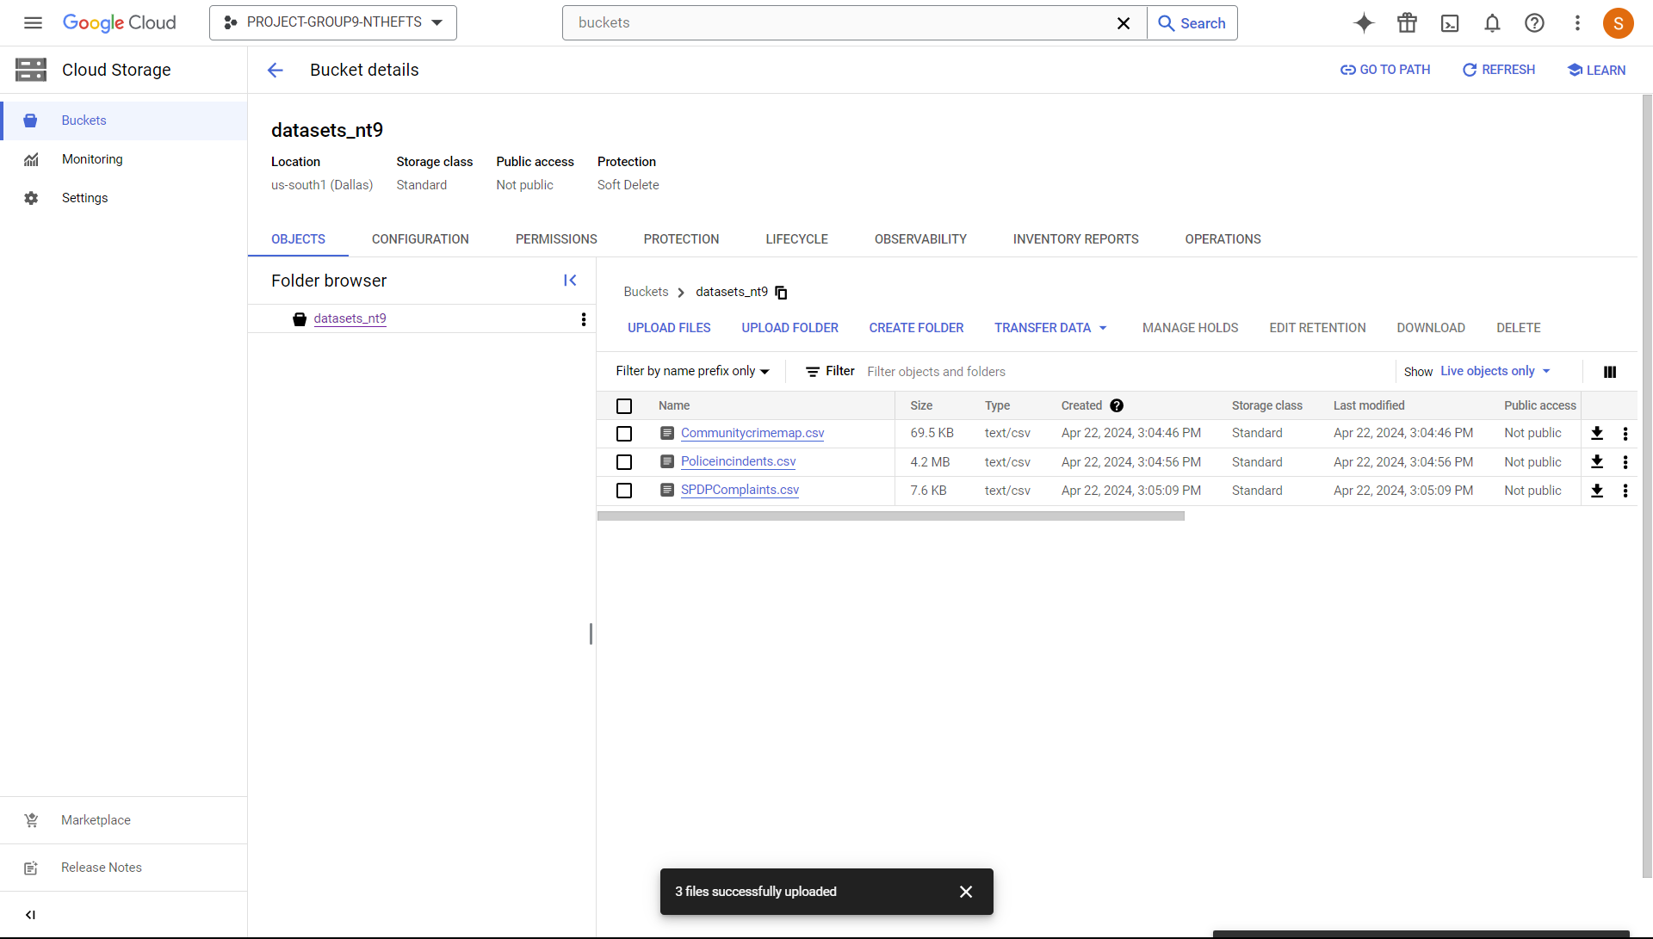

Processed data was stored in Google Storage Buckets
Screenshot - Data Storage Bucket management in Google Cloud Storage
Screenshot - Datasets uploaded into Google Cloud Storage Buckets.
Screenshot by Suprathika Vangari

Slide 11
DATA MANAGEMENT
As part of a crucial step in our data engineering pipeline, we leveraged Google Cloud's Dataproc service to set up Hadoop ecosystem for managing and processing the neighborhood theft data.
We configured the cluster with the following specifications:
Cluster Name: “dataproc-Hadoop-spark-cluster"
Region and Zone: us-central1
Master Node: e2-standard-4 machine type with 128 GB disk size
Worker Nodes: 2 nodes with 128 GB disk size
By utilizing Hadoop environment (HDFS) managed by Dataproc, we were able to focus on the data engineering tasks.

Slide 12
DATA MANAGEMENT
The Dataproc cluster served as the foundation for various stages of our data engineering workflow:
Data Processing: We used the Hadoop Distributed File System (HDFS) under the Dataproc cluster to store the 3 refined datasets, thereby ensuring scalable and reliable data storage.
Data Analysis: Apache Spark and Apache Hive, both of which are pre-installed on the Dataproc cluster, we were able to perform advanced analysis and extract valuable insights from the neighborhood theft data.
Data Management: The Dataproc cluster provided us with a centralized and easily accessible platform for managing the data and running queries to support the project's objectives.
By deploying the Dataproc cluster within the Google Cloud ecosystem, we were able to integrate it with other GCP services, such as Cloud Storage and BigQuery.

Slide 13
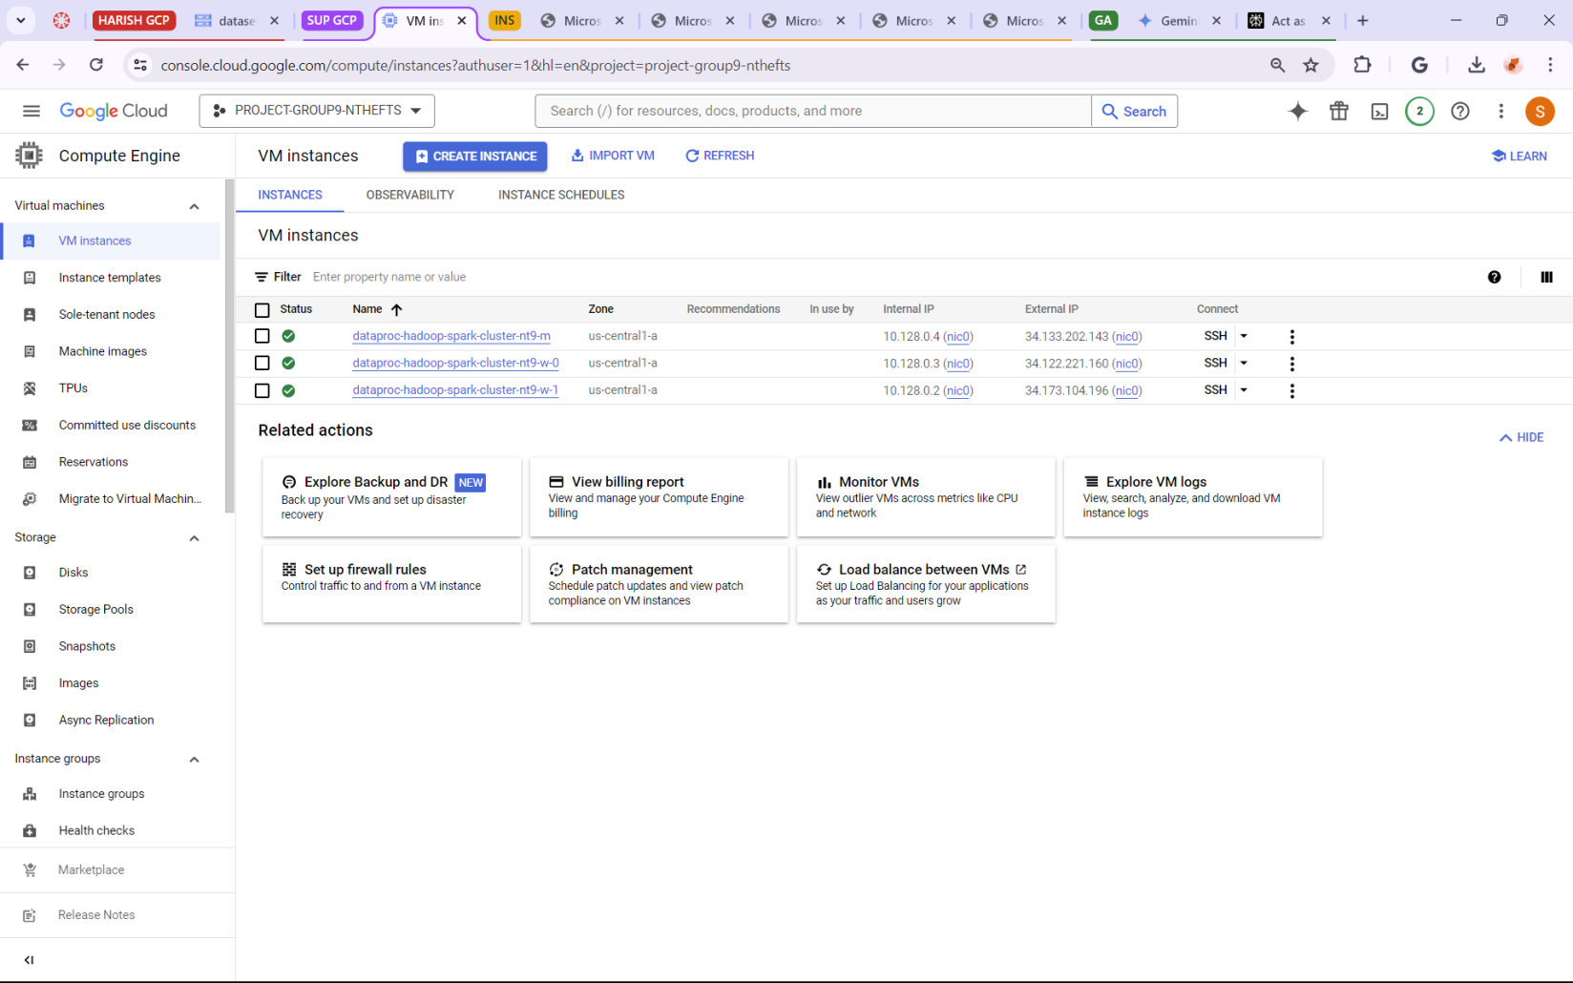
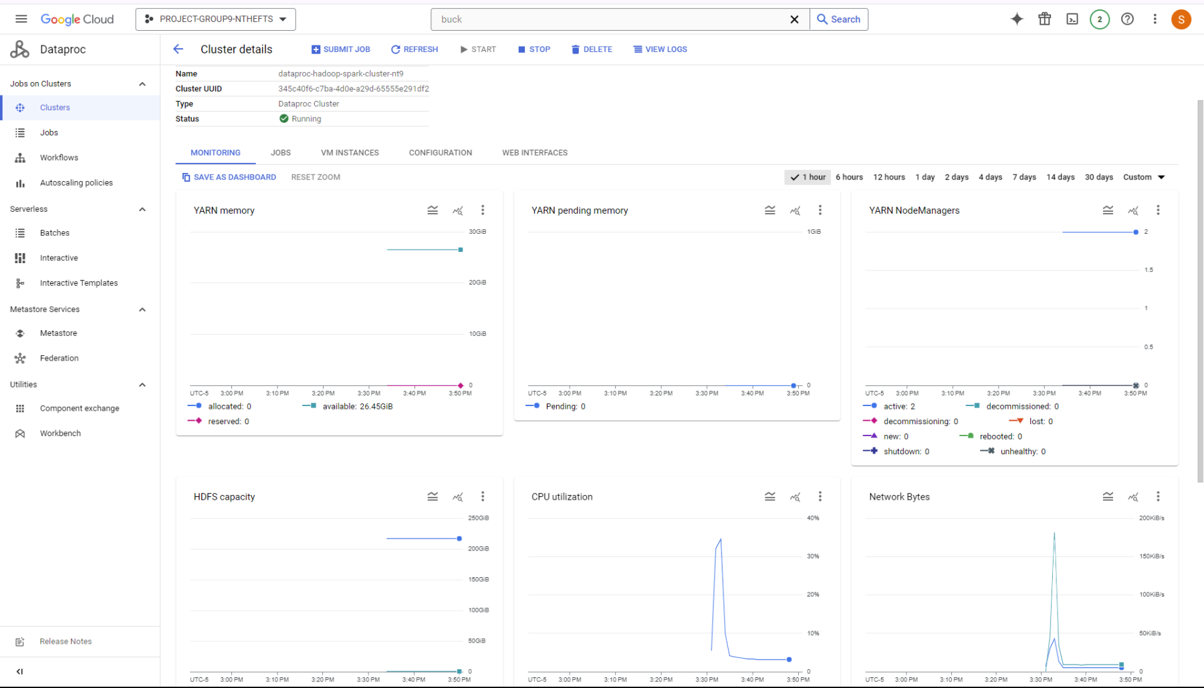
Integration with GCP:
Dataproc's Master and Worker nodes
Monitoring cluster performance
By Vishala Vadla

Slide 14
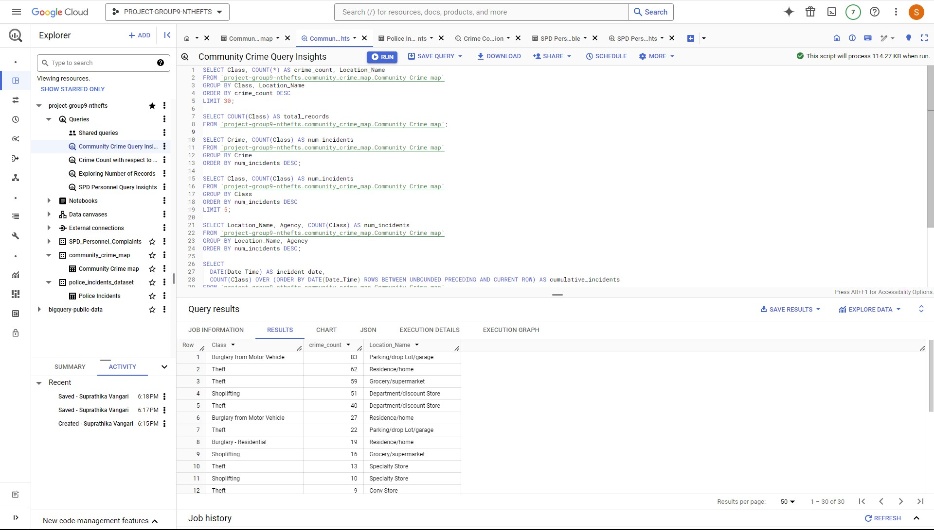
DATA MANAGEMENT WITH BIGQUERY
To manage and query the processed data effectively, we utilized BigQuery -GCP's fully-managed enterprise data warehouse solution.
By creating an external table in BigQuery, we were able to directly access the data stored in our Cloud Storage bucket, streamlining the data management process and enabling us to run sophisticated SQL queries.
Screenshot of querying using Bigquery and results
By Suprathika Vangari

Slide 15
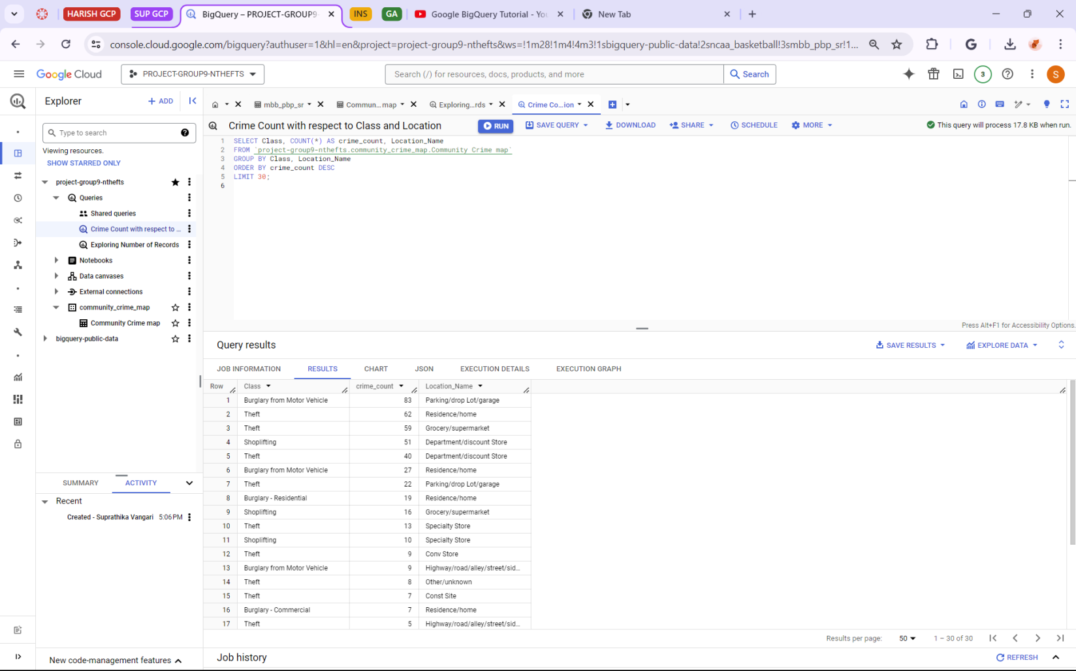
Querying on 3 datasets using BigQuery.
Screenshot – Resultant Crime Class according to crime count and location
By Suprathika Vangari

Slide 16
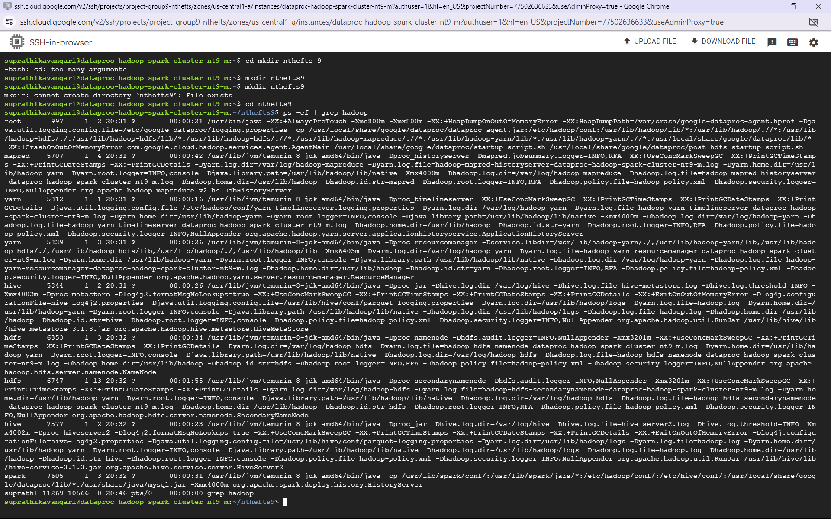
ADVANCED ANALYSIS WITH HIVE & SPARK
To perform advanced analysis on the neighborhood theft data, we utilized Apache Hive, a data warehouse software that provides a SQL-like interface for querying and managing structured data

Slide 17
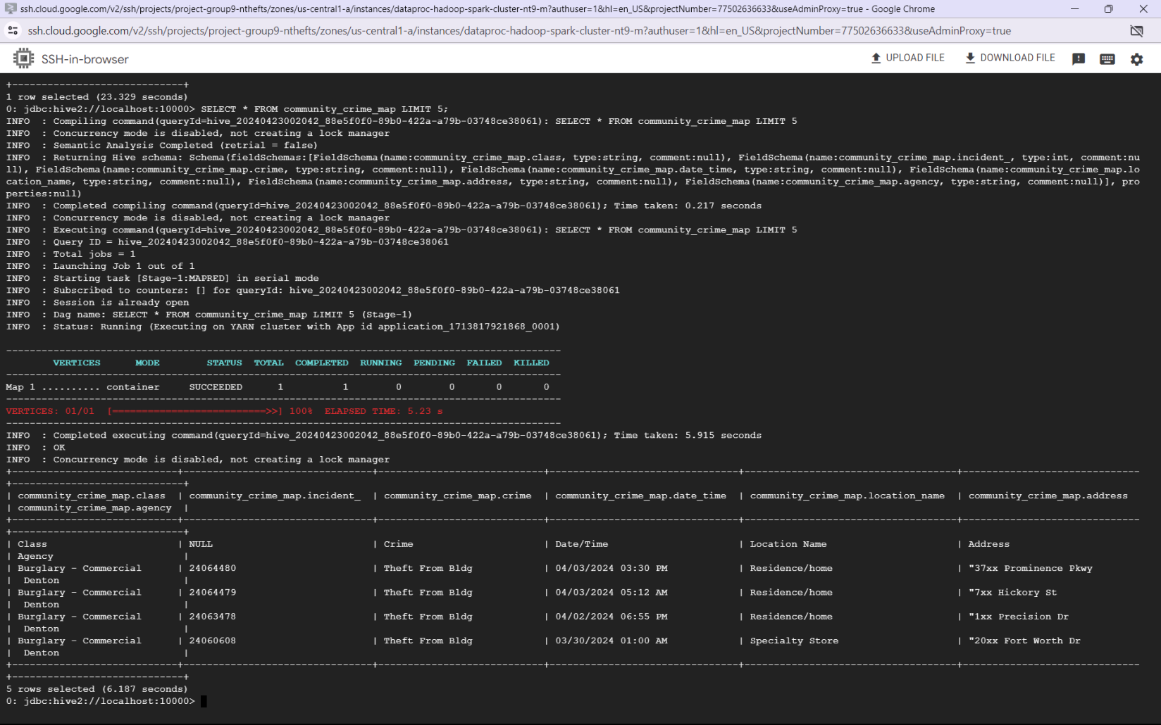
Hive allowed us to define a schema for the data, ensuring a consistent and organized data model for our analysis
Screenshot - Sample HiveQL code snippet for schema definition
By Udaya Adepu

Slide 18
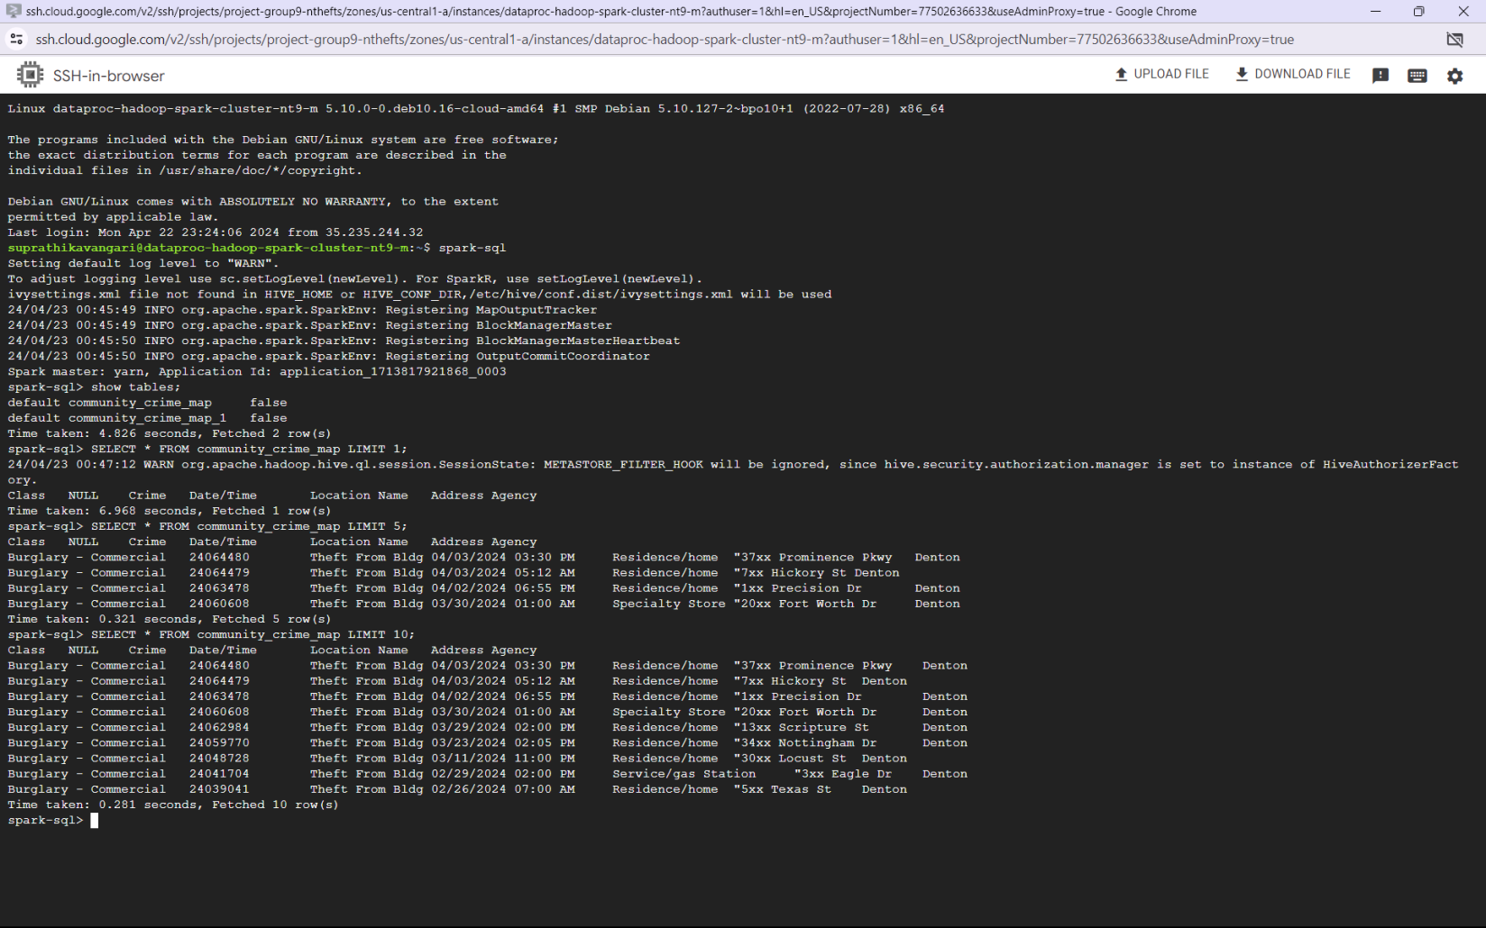

In addition to Hive, we leveraged the power of Apache Spark SQL, to develop custom algorithms and queries tailored to our specific analysis needs.
Snippet of Spark SQL Code and its output
By Suprathika Vangari

Slide 19
KEY FINDINGS & RECOMMENDATIONS
As data engineers, our role was to establish a robust and efficient data pipeline to support the analysis of neighborhood thefts in Denton.
Through our data engineering efforts, we have laid the foundation for data analysts and scientists to uncover valuable insights and develop targeted solutions.
The data engineering processes we implemented, such as data collection, cleaning, and storage, have provided a high-quality and well-structured dataset for further analysis.
Building upon the insights generated from the data pipeline, we have the following recommendations for data analysts and scientists to develop the community reporting data to establish a neighborhood watch program, empowering residents to actively participate in crime prevention and reporting.

Slide 20
CONCLUSION
As data engineers, our role has been to establish a comprehensive and scalable data pipeline to support the analysis of neighborhood thefts in Denton. By employing GCP and data engineering best practices, we have created a foundation for data analysts and scientists to uncover valuable insights and develop data-driven solutions.
Moving forward, we encourage the data analysts and scientists to fully utilize the data pipeline we have established.
Through the integration of various data sources, including police records, community reports, and the data processing, storage, and management techniques we implemented ensure the reliability, accessibility, and scalability of the data, empowering the data science team to focus on advanced analysis and insightful recommendations.

Slide 21
REFERENCES
Codible. (2021, January 28). Connecting to a Hadoop cluster on Google Dataproc with Jupyter Notebook [Video]. YouTube. https://www.youtube.com/watch?v=SN2VDCBzSlE
Exploring facets | OpenRefine. (2022, November 24). https://openrefine.org/docs/manual/facets​
8 steps in the data life Cycle | HBS Online. (2021, February 2). Business Insights Blog. https://online.hbs.edu/blog/post/data-life-cycle​
Linux Training Academy. (2022, November 6). We help IT professionals Level-Up their careers by teaching them practical Linux skills. | Linux Training Academy. https://www.linuxtrainingacademy.com/​
Referred assignments from Week-5 to Week-12

Slide 22
THANK YOU!

